Slide 1
Title of project: pendulum waves
In the name of God

Slide 2


Pendulums Waves

Slide 3
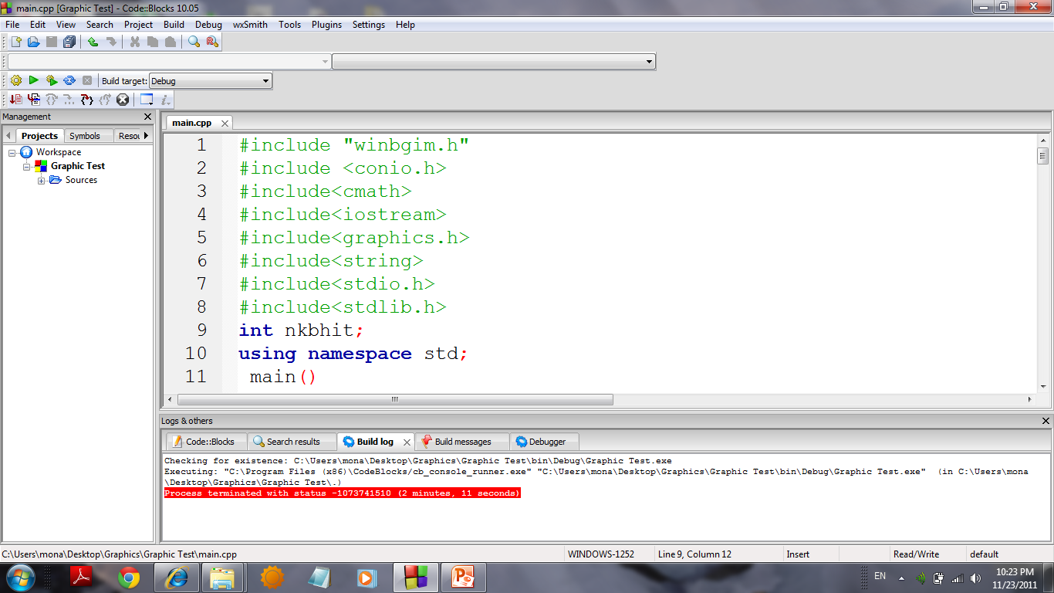

Slide 4
To start a graphic program first we should include some graphics library #include<graphics.h> #include”winbgim.h” To run this program, you need graphics.h header file, graphics.lib library file and Graphics driver (BGI file) in the program folder.

Slide 5
After we write int main we need to type these 2 lines int gd=DETECT,gm=0; initgraph(&gd,&gm,""); Dont forget to write DETECT with capital letters. These 2lines enable us to enter to the graphic page.

Slide 6
InitGraph: Initializes the graphics system. Declaration: void far initgraph(int far *graphdriver, int far *graphmode, char far *pathtodriver); Remarks: To start the graphics system, you must first call initgraph. initgraph initializes the graphics system by loading a graphics driver from disk (or validating a registered driver) then putting the system into graphics mode. initgraph also resets all graphics settings (color, palette, current position, viewport, etc.) to their defaults, then resets graphresult to 0. Arguments:

Slide 7
gd:*graphdriver: Integer that specifies the graphics driver to be used. You can give graphdriver a value using a constant of the graphics drivers enumeration type. gm:*graphmode : Integer that specifies the initial graphics mode (unless *graphdriver = DETECT). If *graphdriver = DETECT, initgraph sets *graphmode to the highest resolution available for the detected driver. You can give *graphmode a value using a constant of the graphics_modes enumeration type. pathtodriver : Specifies the directory path where initgraph looks for graphics drivers (*.BGI) first. If they're not there, initgraph looks in the current directory. If pathtodriver is null, the driver files must be in the current directory. This is also the path settextstyle searches for the stroked character font files (*.CHR).

Slide 8
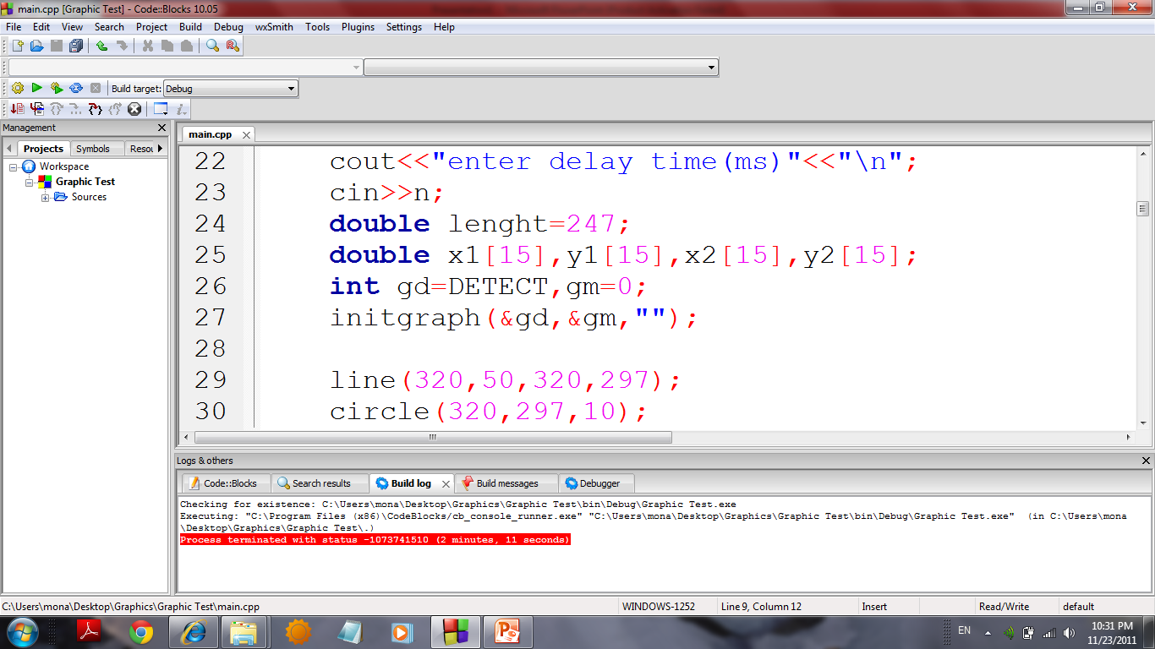

Slide 9
If u want to draw a line u should write this order line(int x0,int y0,int x1,int y1); x0,y0 are coordinate of the first of line &x1,y1 are coordinate of last of line If u want to draw a circle u should write this order circle(int x,int y,R); R is radius of circle &x,y are coordinate of center of circle.

Slide 10
We need to use arrays to introduce x[i],y[i],l[i]. we need arrays to make our codes easier to write. At first of my code I want u to input the number of pendulums.

Slide 11
To calculate the length of pendulums we know 16T=17Ta,16T=18Tb,… so La=(16/17)^2 L,… so if we have the length of L we can calculate the other length. That I use for loop for it.

Slide 12
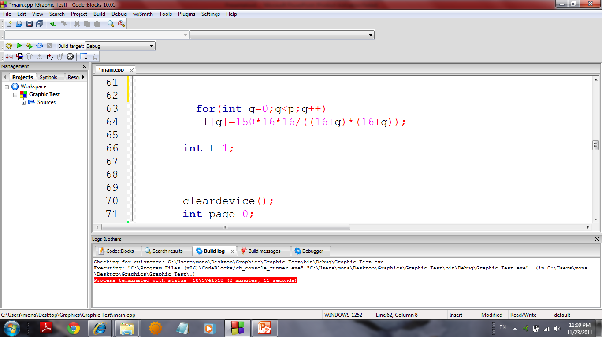

Slide 13
Each pendulums in the t s second is in the place which the coordinate of x is x=Asin(wt) &we can calculate the coordinate of x,y. To change the color of pen we use: setcolor(i); 0=<i<=15

Slide 14
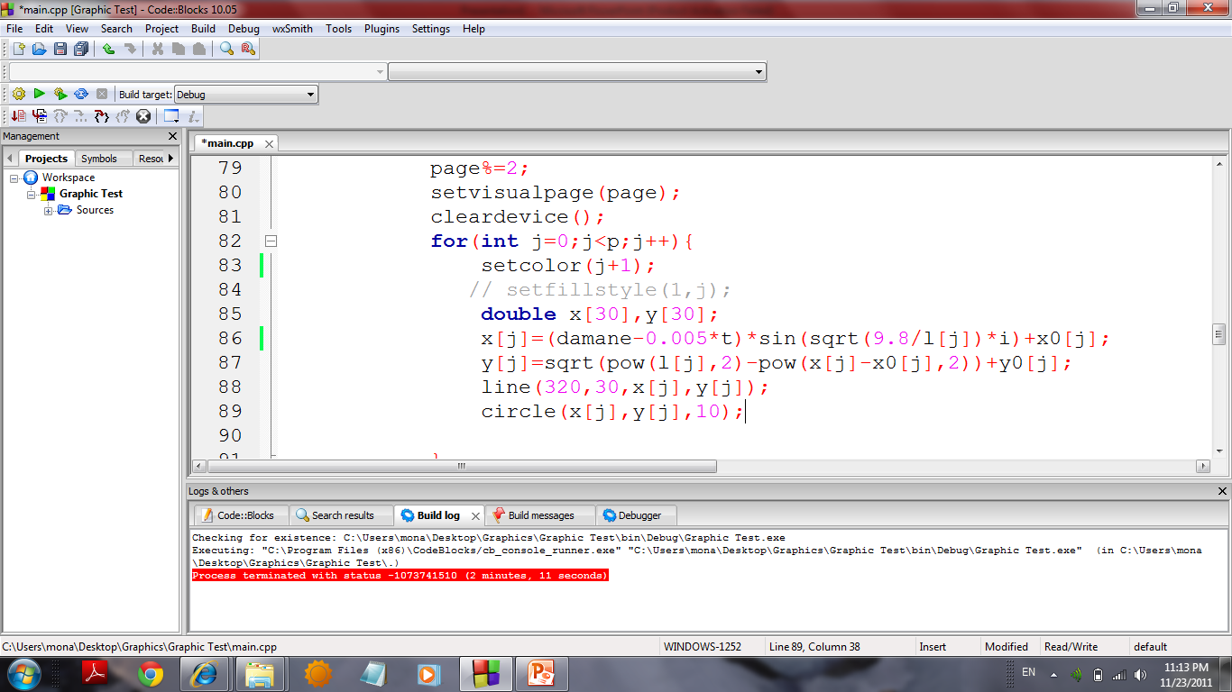

Slide 15
In each loop I draw pendulums & I use this order to delay for alittle time. Delay(milli second); & after that I earase the pendulums by: cleardevice(); which clear the page.

Slide 16
How to Fix the flickerings? To fix the flickerings we need to draw a picture in one page & draw next picture on the other page & change the page in each loop. The orders are setactivepage(int x); setvisualpage(int x);

Slide 17
In each loop,we substract from the amplitude of pendulums,if(amplitude==0) break;

Slide 18
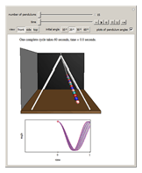

Slide 19
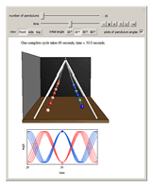

Slide 20
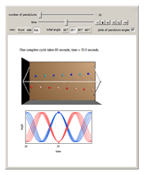

Slide 21
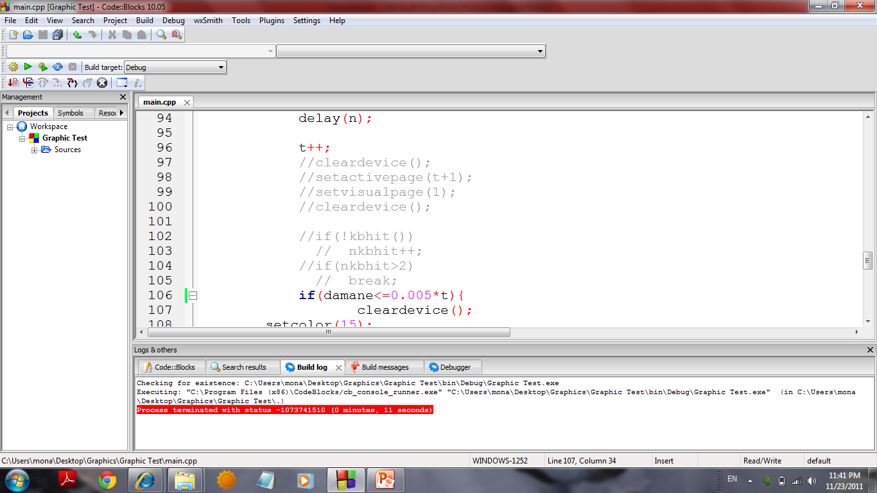

Slide 22
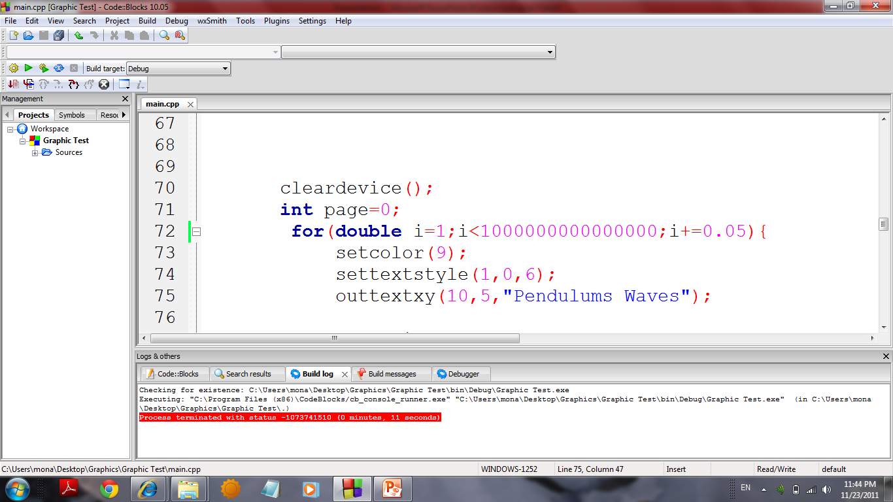

Slide 23
We can write a text in graphic page by: settextstyle(int x,int y,int z); x=change the kind of writting y z=size of text outtextxy(int x,int y,” text ”);

Slide 24
Thanks from Dr.Bahrami Mojdeh karbalaee Motalleb Good luck!

